Slide 1
PayCore Pvt. Ltd. Employee Performance & Benefits Analytics
To analyze employee performance, salary trends, and benefits distribution for data-driven decision-making using SQL.
Nitin Bhagat

Slide 2
The project aims to analyze employee performance, salary trends, and benefits enrolment using SQL-based data management. The system provides valuable insights to HR teams, allowing them to improve employee retention, salary fairness, and benefits optimization.
Objective:
Skills Demonstrated:
✅ SQL (DDL, DML, DQL, DCL)
✅ Data Normalization & Indexing
✅ Joins, Subqueries, Aggregate Functions
✅ Handling Foreign Key Constraint
✅ Normalization & Data Integrity

Slide 3
Problem Statement
Scenario: PayCore Pvt. Ltd. has thousands of employees working across different departments. The HR team struggles to track salary distribution, benefits enrolment, and performance metrics. They also need to identify trends like high attrition, salary gaps, and top performers.
Challenges:
Salary Distribution: Analyzing salary trends across departments and job levels..
Benefits Tracking: Identifying employees without benefits and updating records.🔹
Attrition Analysis: Tracking employee turnover trends over time.🔹 Top Performers:
Ranking employees based on performance and bonuses.

Slide 4
Database Design Overview
Database Components – Tables:
Employees: Stores employee details (ID, Name, Gender, Department, Job Level, Salary, etc.).
Departments: Contains department-wise details and employee distribution.
Salaries: Tracks salary, bonuses, and pay structure.
Benefits: Maintains records of employee benefit enrollments.
Performance: Stores employee performance ratings and appraisals.

Slide 5
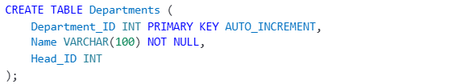
SQL Query Implementation
Creating the database and using it:
Creating table Departments:

Slide 6
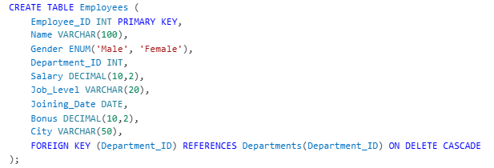
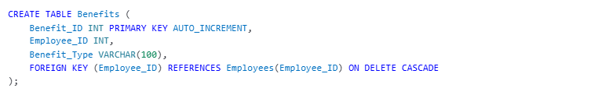
Creating table Employees:
Creating table Benefits:

Slide 7
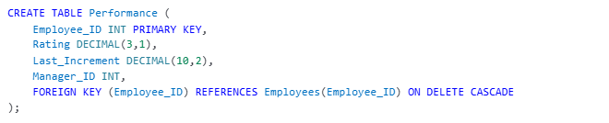
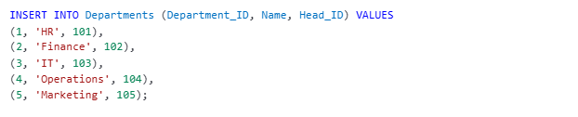
Creating table Performance:
Inserting Data into Departments:

Slide 8
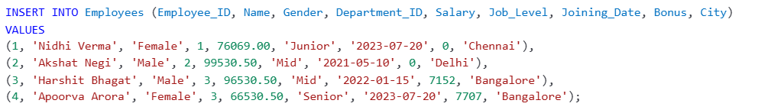

Inserting Data into Employees:
Inserting Data into Benefits:
Inserting Data into Performance:

Slide 9
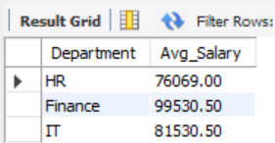
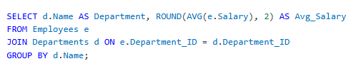
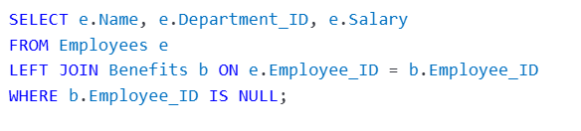
Find the Average Salary by Department
List Employees Without Any Benefits

Slide 10
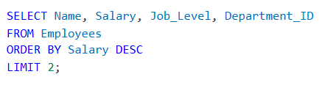
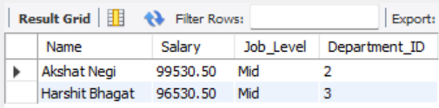
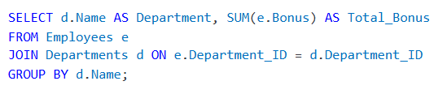
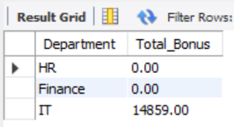
Identify Top 2 Highest Paid Employees
Find the Total Bonus Paid per Department

Slide 11
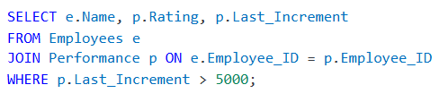

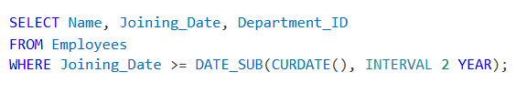
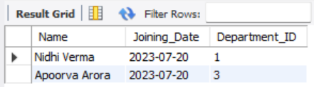
Find Employees Who Received a Salary Increment Greater Than 5000
Find the Total Bonus Paid per Department

Slide 12
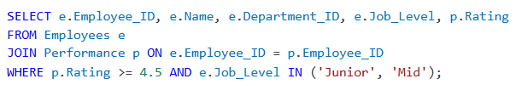
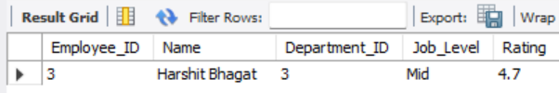
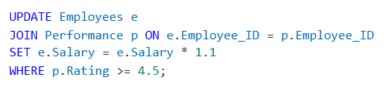
Identifying Employees Eligible for Promotion
Updating Employee Salary Based on Performance

Slide 13
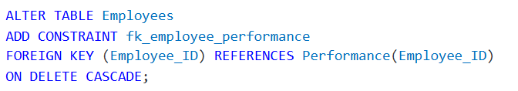
Deleting an Employee (Handling Foreign Key Constraints)
⚠️ If there's a foreign key issue, use:

Slide 14
Challenges Faced | Solutions Implemented
Handling Missing Benefits Data | Used LEFT JOIN to find employees without benefits and updated the table.
Ensuring Data Integrity | Implemented foreign key constraints and ON DELETE CASCADE.
Optimizing Performance Queries | Used indexing on Employee_ID, Department_ID for faster queries.
Finding High Performers Efficiently | Used aggregate functions and filters on Rating and Last_Increment.

Slide 15
Conclusion 🚀
The project successfully analyzes salary distribution, benefits enrollment, and employee performance using SQL.
HR teams can now identify high performers, salary gaps, and department-wise trends efficiently.
Data integrity and query optimization ensure a fast and reliable HR analytics system.

